Slide 1

How to survive in a COVID-19 pandemic economy ?
Reinventing Restaurants: A Data Based Approach
Capstone Project:
Battle of the Neighborhoods
by Ayan Guha

Slide 2
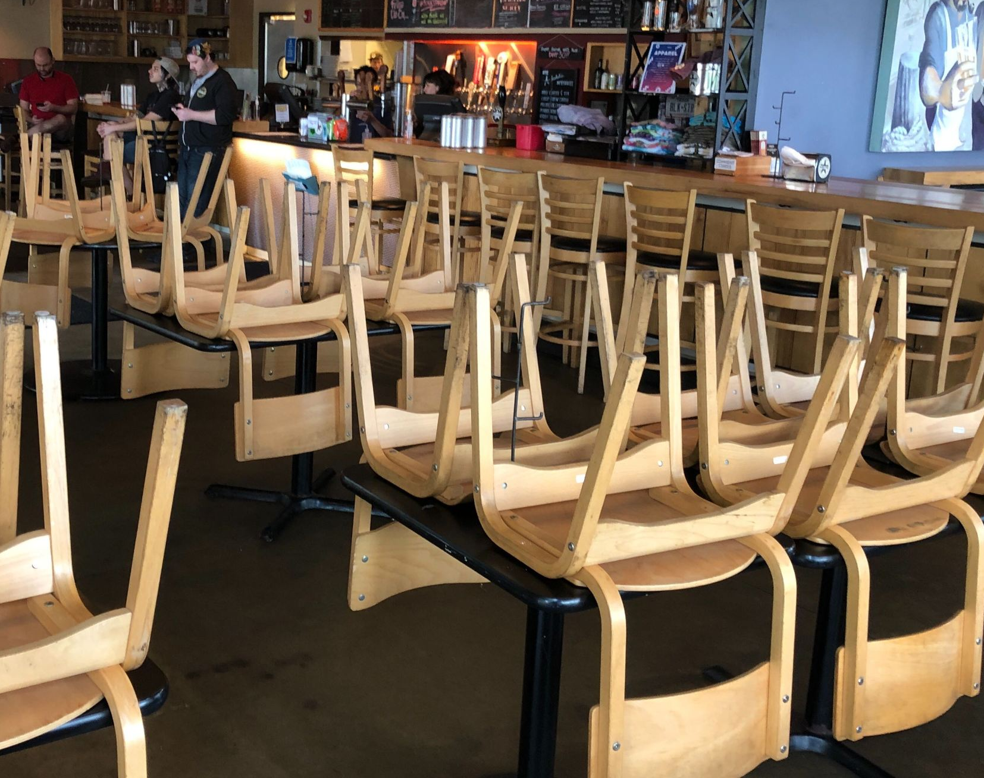
Introduction
Restaurants are shuttered due to COVID-19 pandemic
Customer base is quarantined in their homes
A mobile restaurant can visit the customers in their neighborhoods
It is time for a transition
Business problem ?
Which neighborhoods should the restaurant visit ?

Slide 3

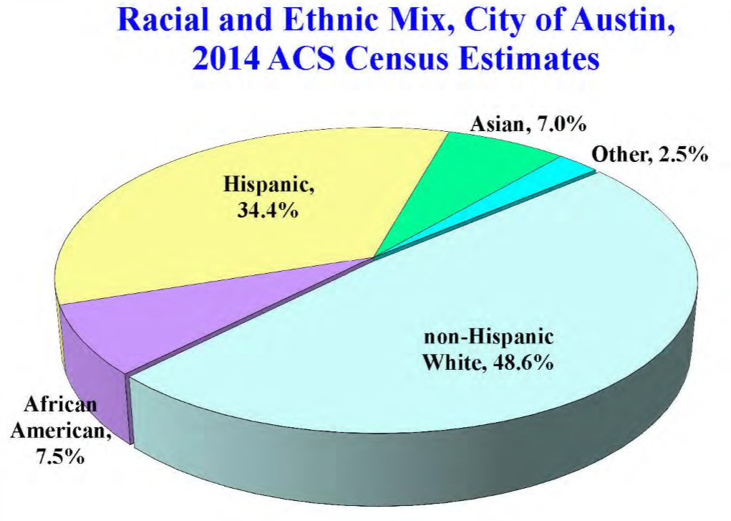
Data Source
Exploring the Neighborhoods in Austin:
data.austintexas.gov (https://data.austintexas.gov/) :
United States Census Bureau (https://www.census.gov/data.html

Slide 4
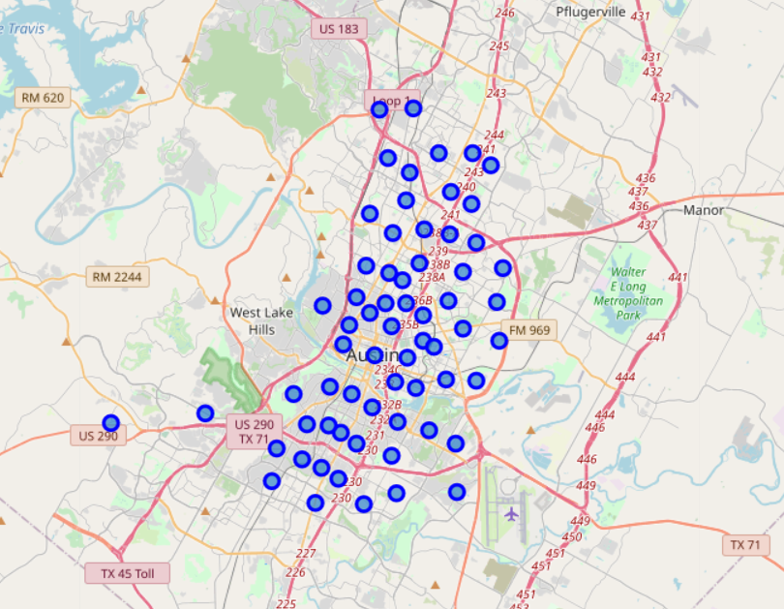
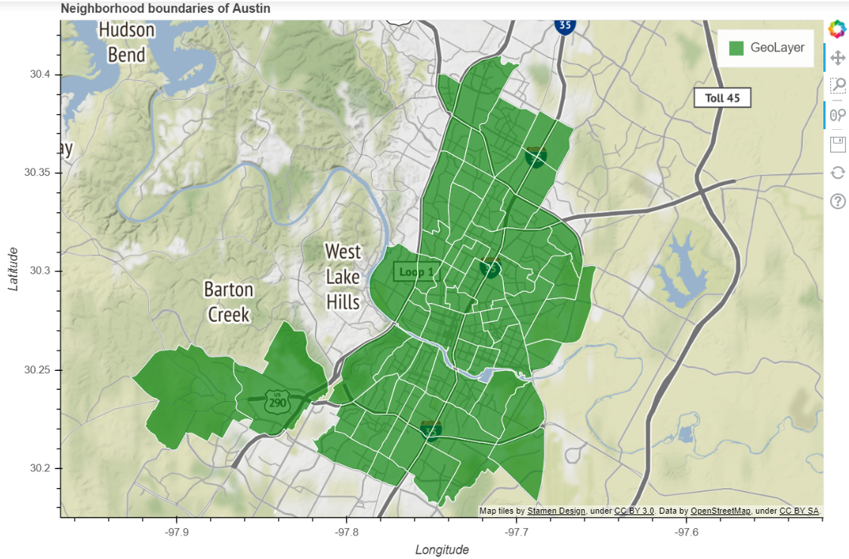
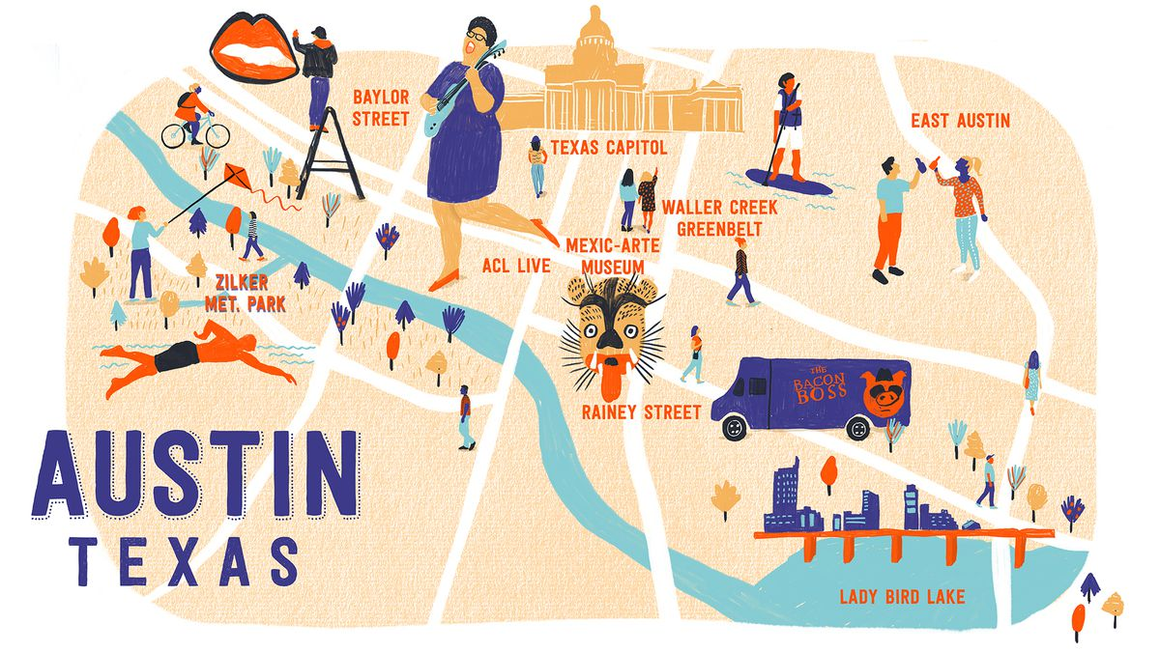
Neighborhoods in Austin
There are 65 neighborhoods in Austin:
Data cleaned, Put in a dataframe & Calculated Centroids of neighborhoods
Neighborhood centroids

Slide 5
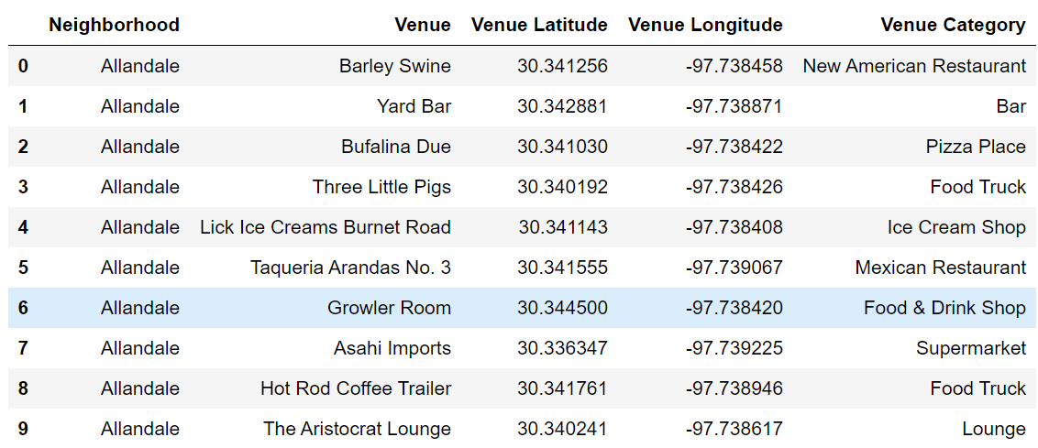
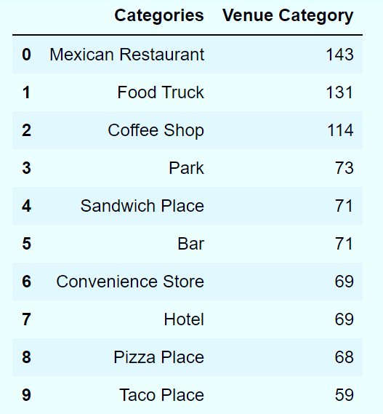
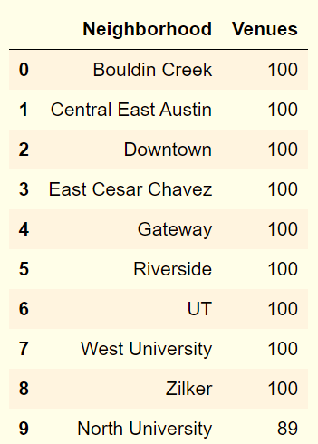
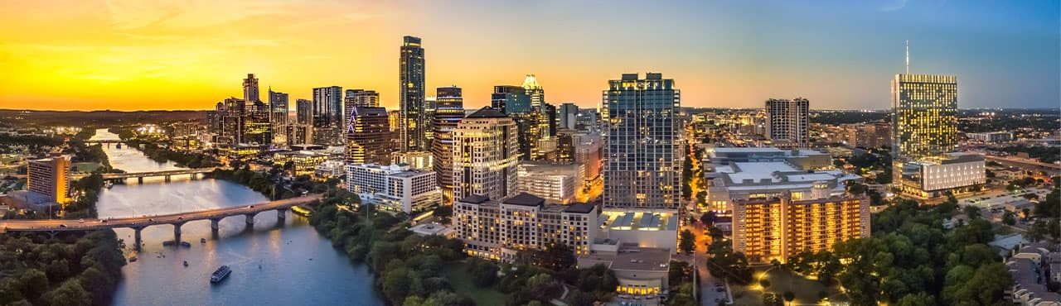
Popular Categories
Using Foursquare API :
We explored all the trending venues within 1000m of each Centroid location
The most popular categories are “Mexican Restaurants” followed by “Food Trucks”
Austin has the fastest-growing food truck industry in U.S. & 2nd most food trucks per capita
2nd downtown is taking shape in Gateway, which returned large number of venues along with Central Austin neighborhoods

Slide 6
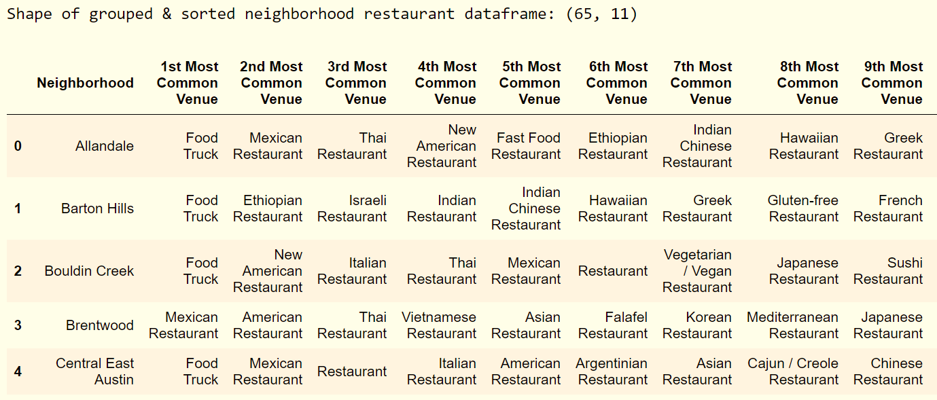
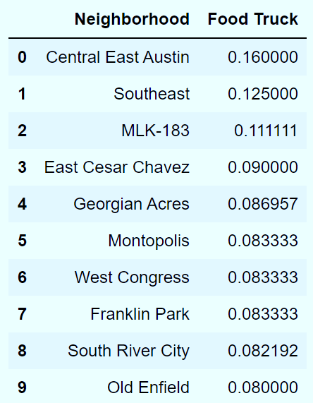
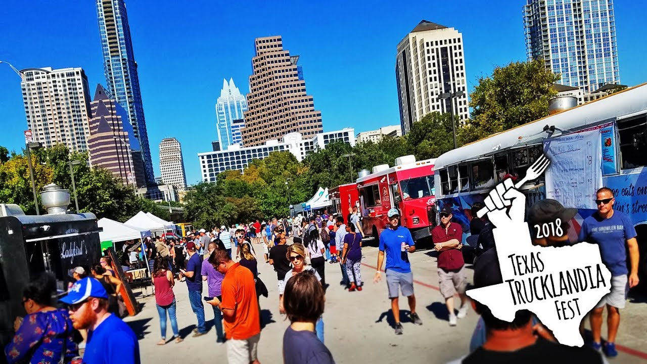
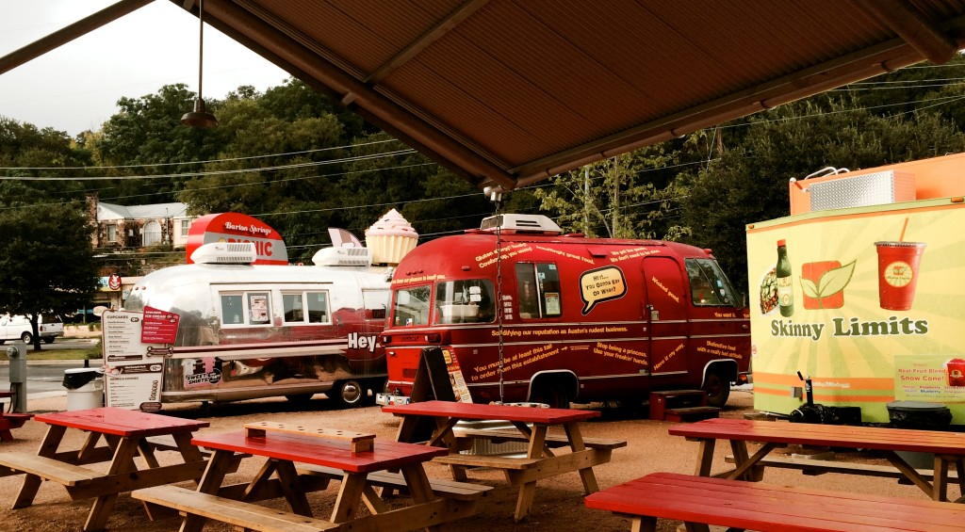
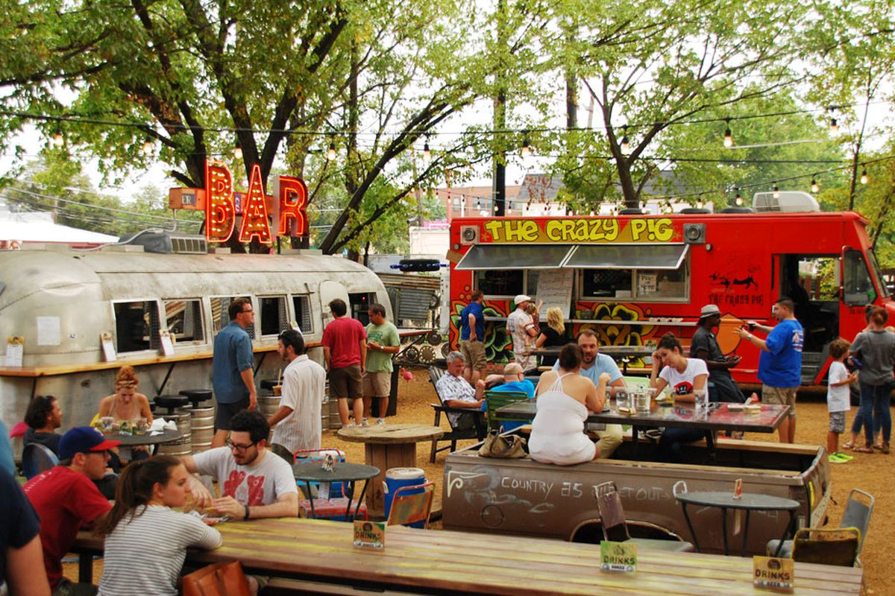
Where are the food trucks?
Restaurants & Food Truck Dataframe :
Segmenting neighborhoods based on Restaurant & Food Truck Categories
Central East Austin has the highest number of food trucks followed by Southeast & MLK-183.
East & Southeast Austin are hottest locations for Food Trucks.

Slide 7
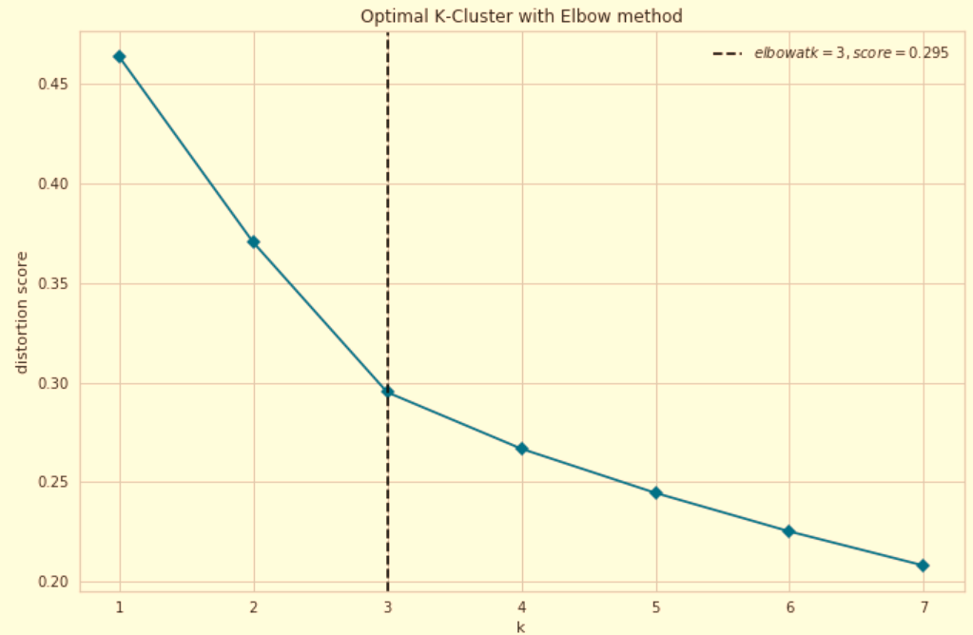
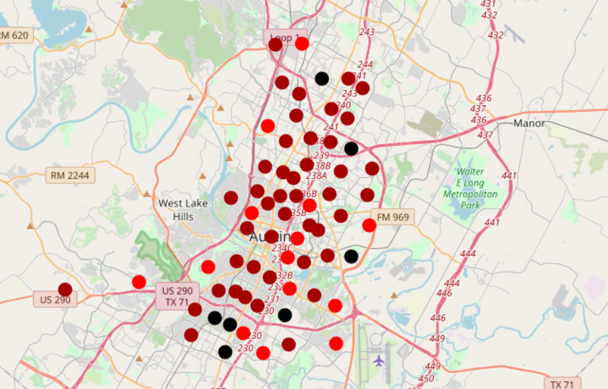

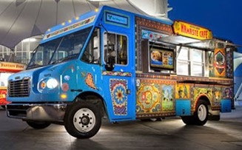
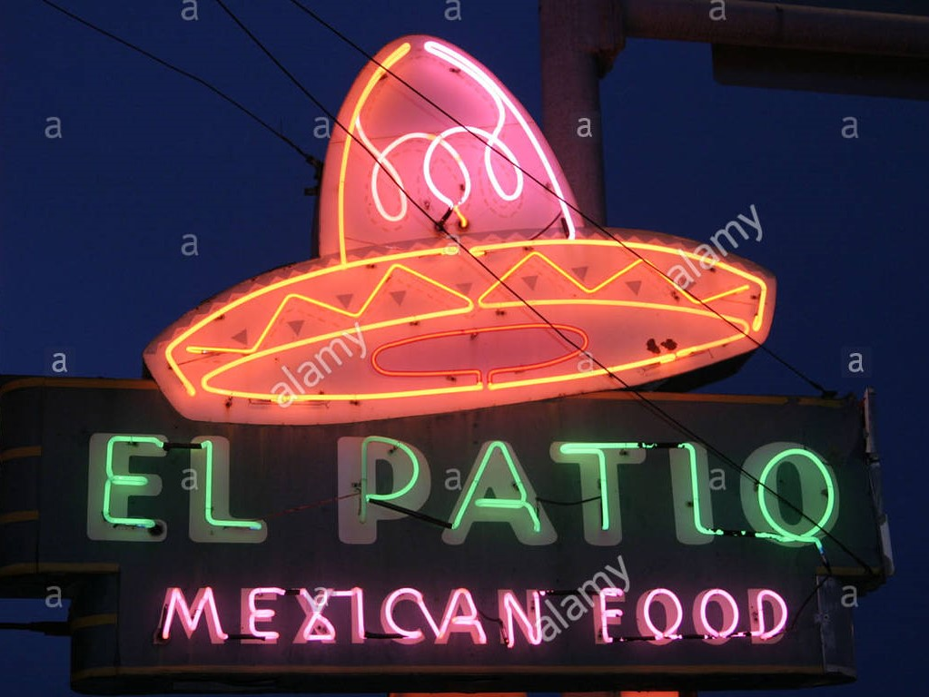
How many optimum clusters?
k-Means Clustering :
An iterative algorithm that partitions the dataset into non-overlapping clusters
Performed k-means clustering on the hot-encoded Restaurant dataframe, k = 3
Cluster locations
K_{clusters} = 3
kElbowVisualizer implements the “elbow” method to select the optimal number of clusters
Cluster Label | Marker Color | 1st Most Common Venue
0 | Red | Food Truck
1 | Magenta | Multi-cuisine restaurants
2 | Black | Mexican Restaurants

Slide 8
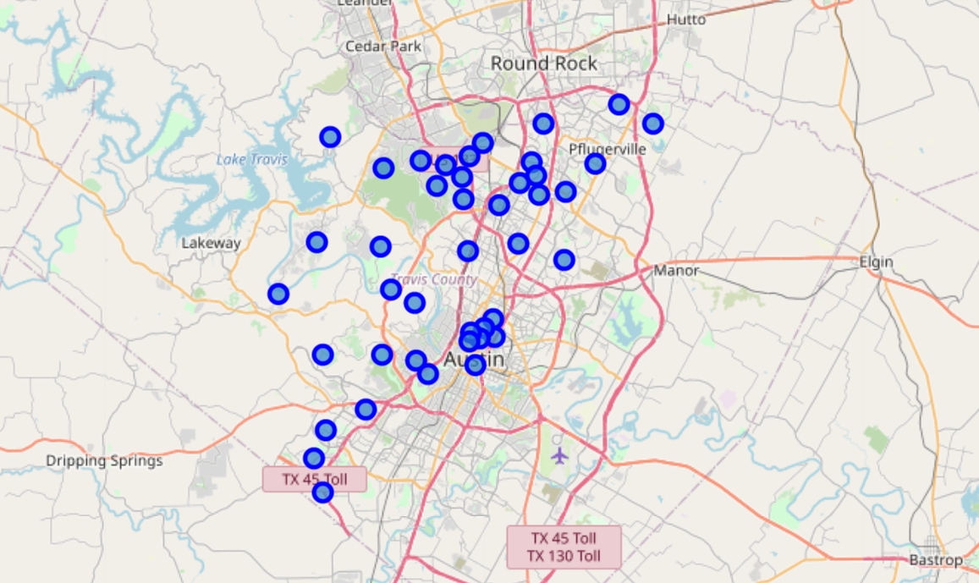
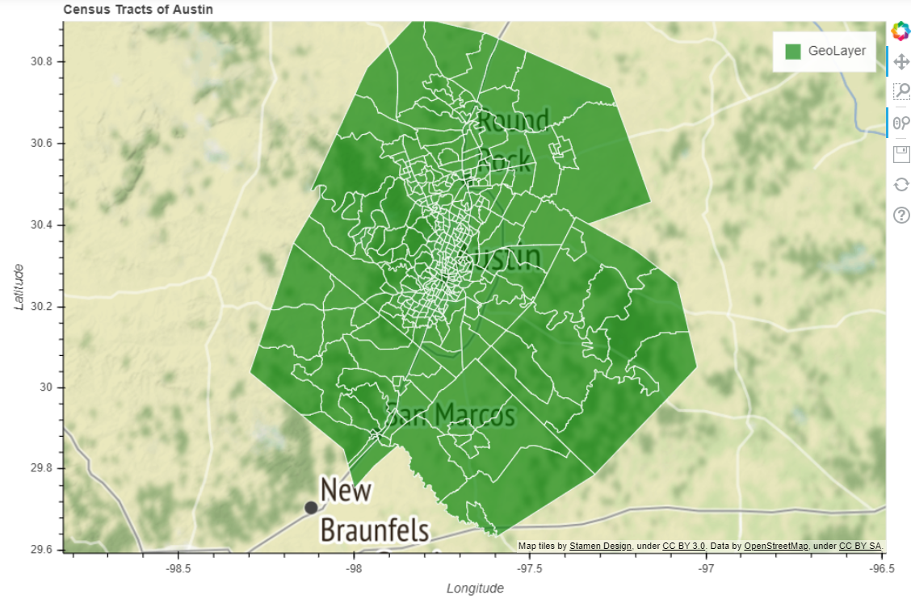

Census Tract Centroids (Travis County)
Let us look at the Census Tracts in Austin:
Data cleaned, Put in a dataframe & Calculated Centroids of Census Tracts
Travis County, whose county seat is Austin, is the fifth most populous county in Texas
Goal: To find the tracts where Asian Indians live and if there is any underserved restaurant business in any of those locations.

Slide 9
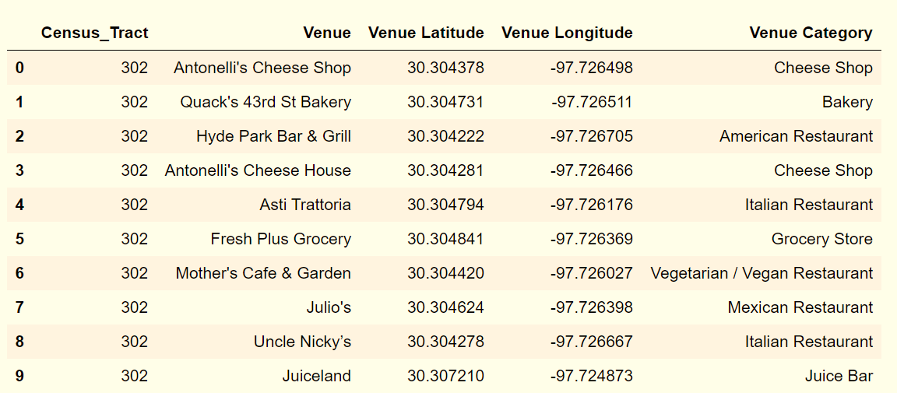
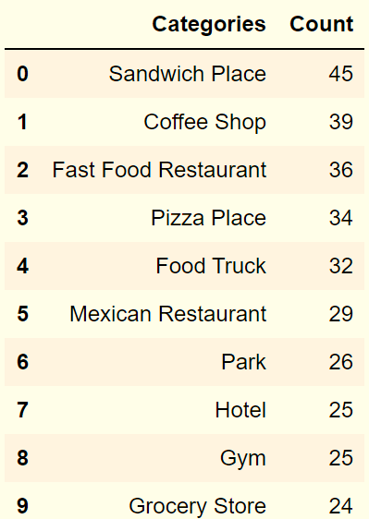
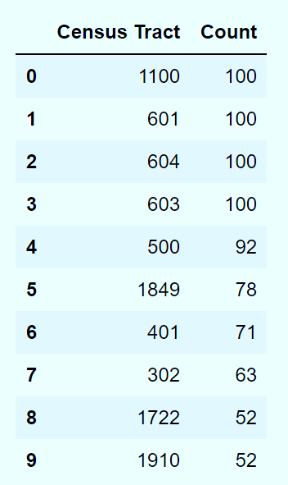

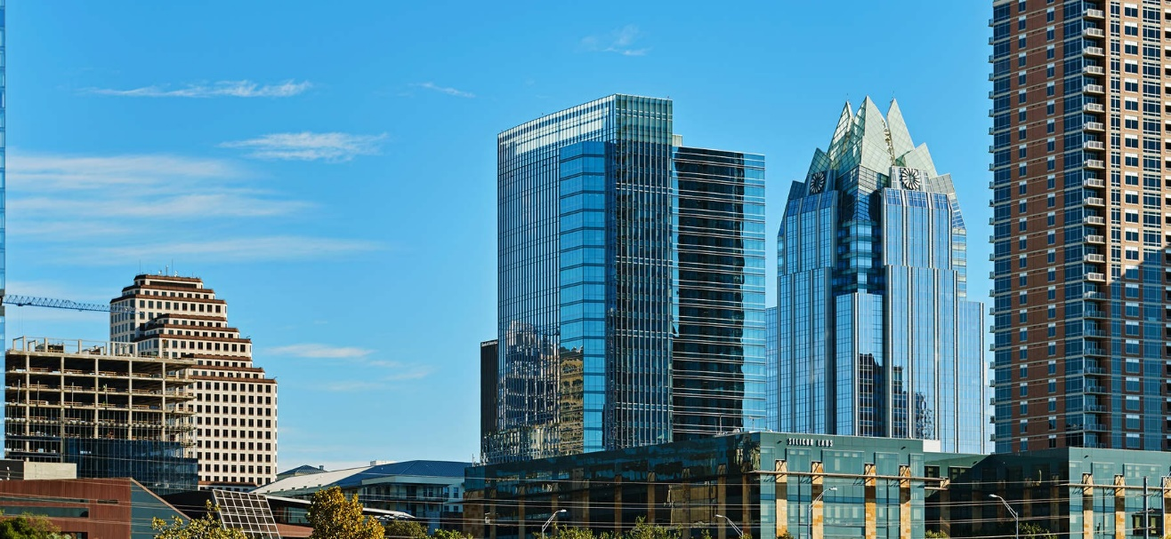
Popular Categories
Using Foursquare API :
We explored all the trending venues within 1000m of each Census Tract Centroid
The most popular categories in Travis County are sandwich shops followed by coffee shops
Census tract # 1100 (Downtown Austin)

Slide 10
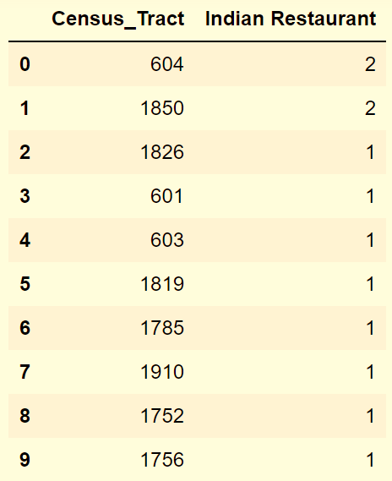
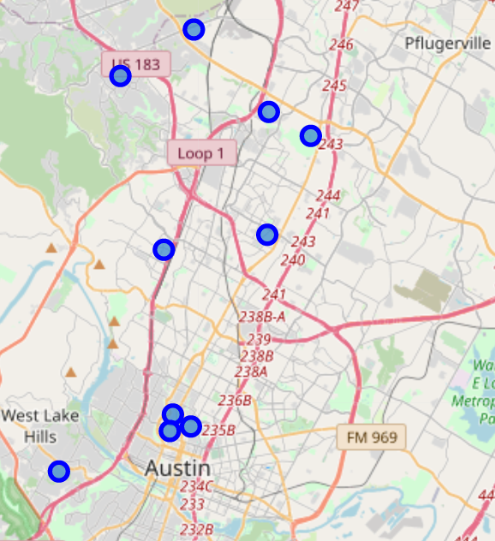
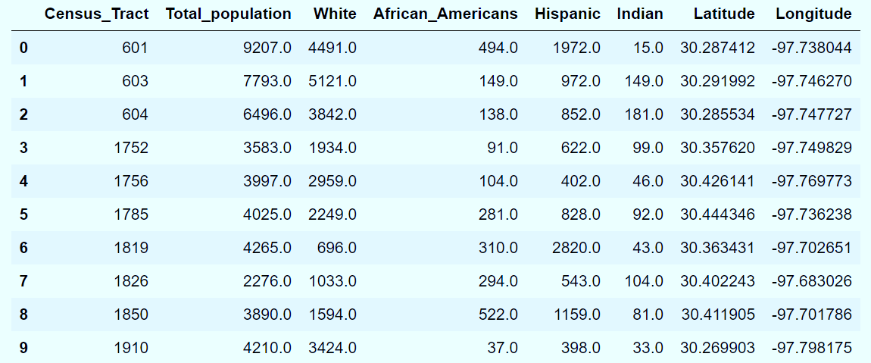

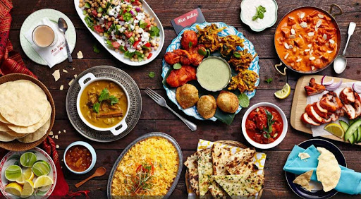
Census Dataframe (for Tracts with Indian Restaurants)
How many Indian restaurants in Travis County ?
Grouping Census Tract dataframe by occurrence of Indian Restaurant
Demographic information of these 9 Census Tracts
Location of Indian Restaurants
There are 12 Indian restaurants in Travis County
These restaurants are spread over 9 Census tracts
Census Tract # 1850 and # 604 returned two restaurants each

Slide 11
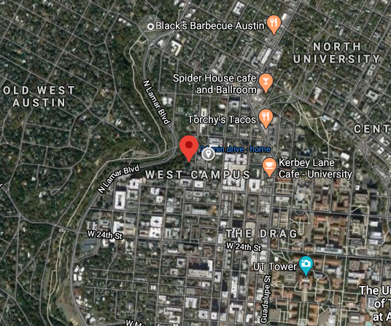
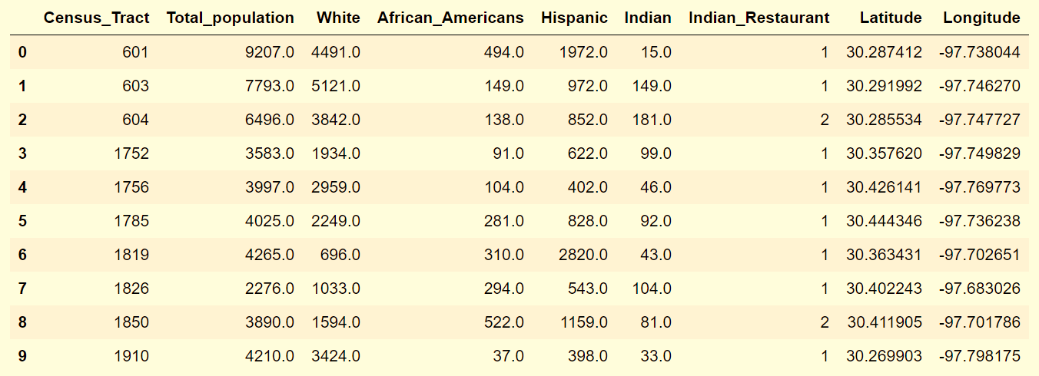
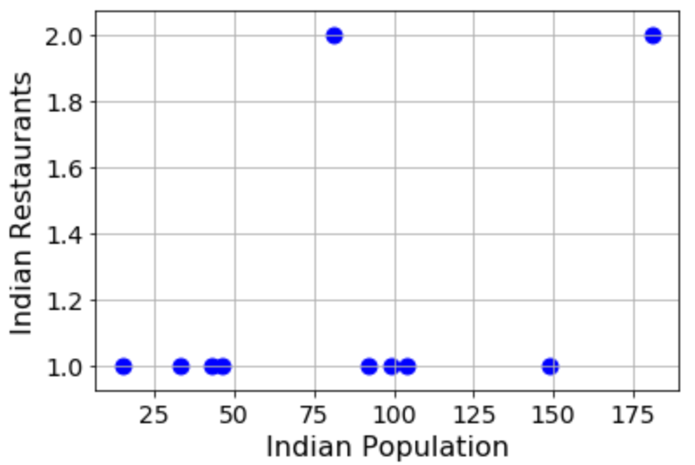
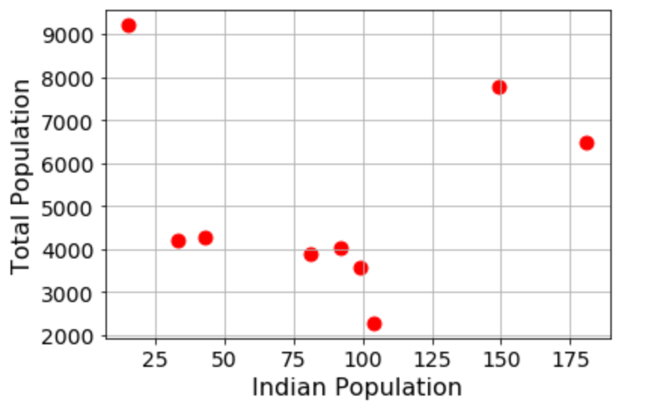
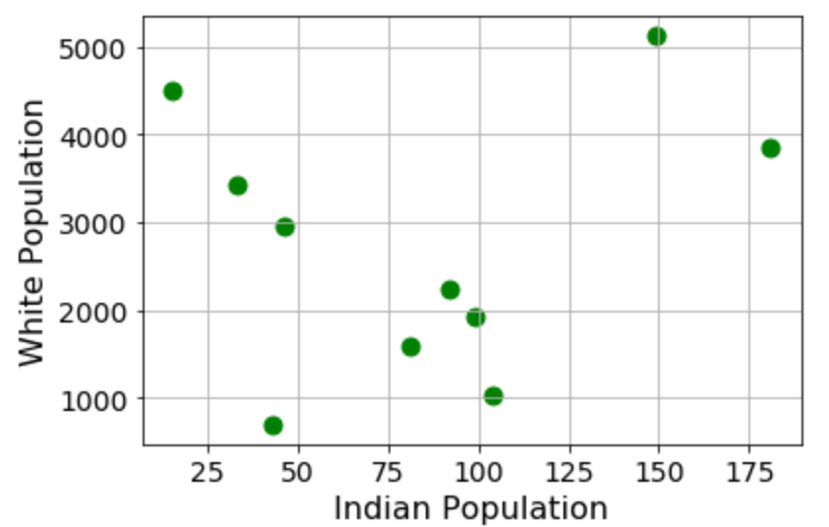
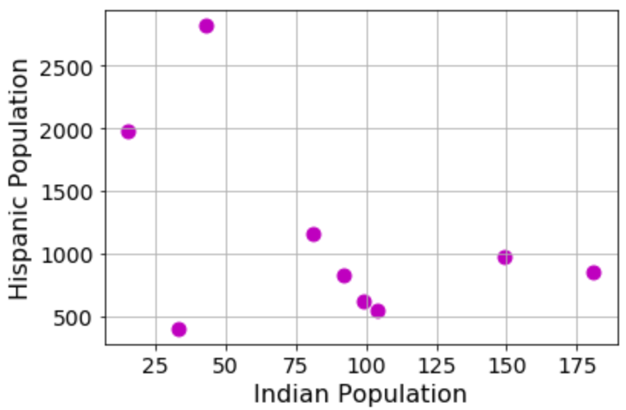
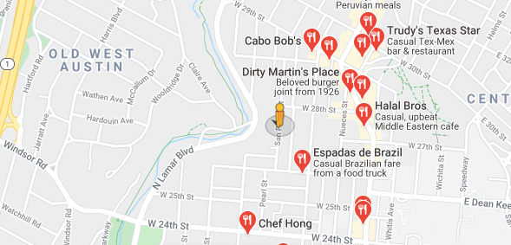
Our final Data Frame:
Includes (a) White, African American, Hispanic, Asian Indian population (b) Indian Restaurant and (c) Centroid co-ordinates
# 603 is next to the University of Texas, 2nd highest Asian Indian population but served by only 1 Indian Restaurant
Tract # 603 is an underserved Restaurant business location

Slide 12
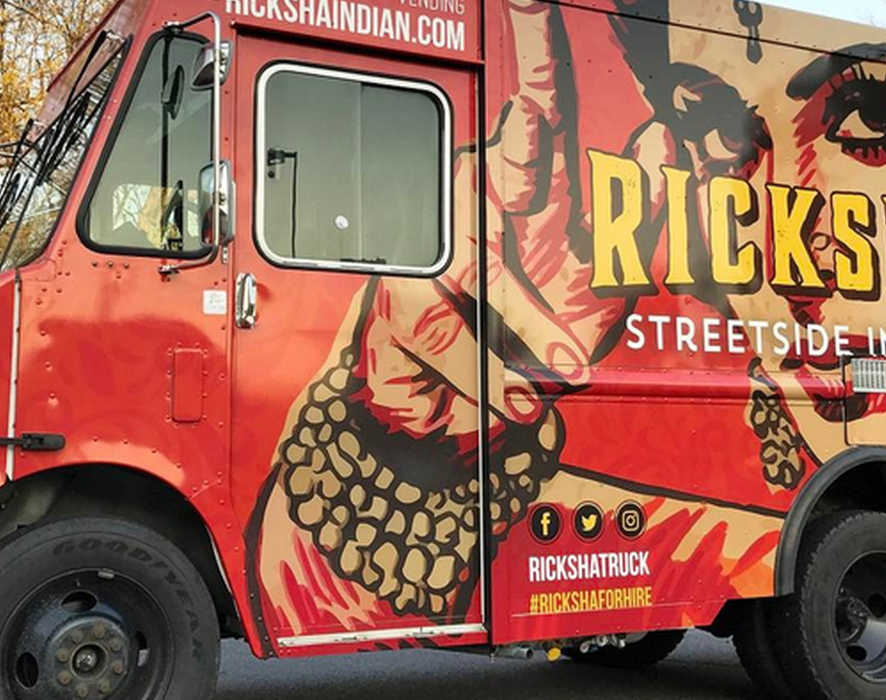
Conclusions:
Our goal was to find a profitable location to start a mobile food business catering to Asian Indian population
Using k-Means algorithm we created 3 unique clusters of restaurants & food trucks
Analyzing Census Data we pinpointed the tract where a mobile restaurant can serve an underserved population
Census Tract # 603 (within Cluster #1) is the optimum location that would satisfy our goal.

